Slide 1

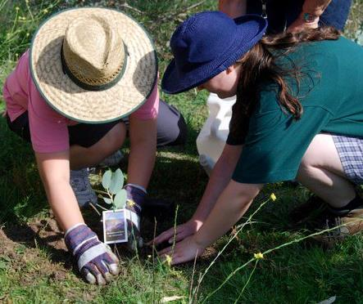
The Five Leaf
Eco-Awards
An Ecumenical Environmental Change Program for churches and religious organisations.
Celebrating
10 years!
2008 - 2018

Slide 2
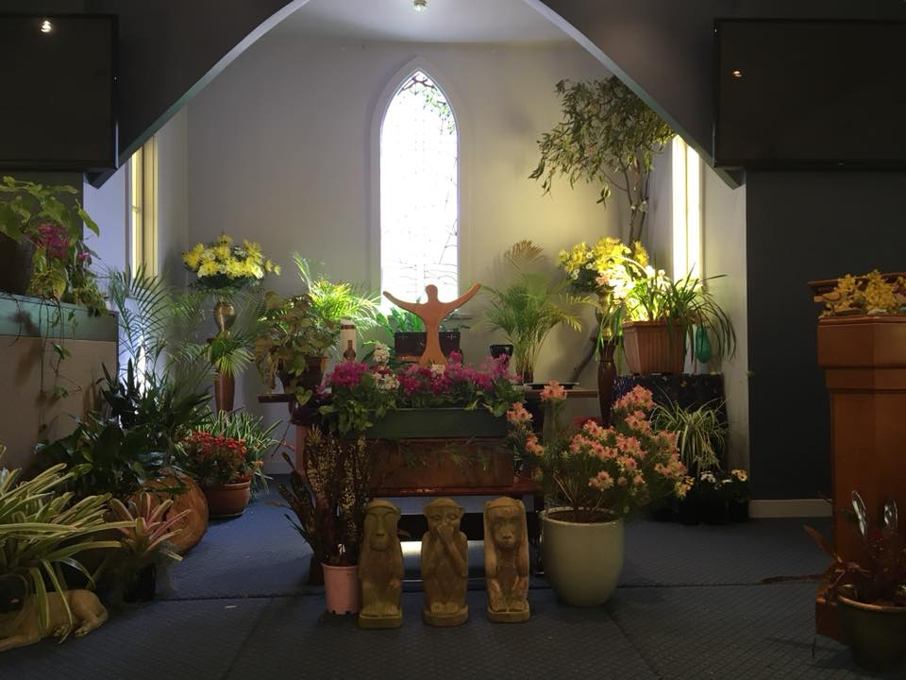
Prayer of Praise & Thanksgiving
Pic: Glenbrook Uniting Church

Slide 3
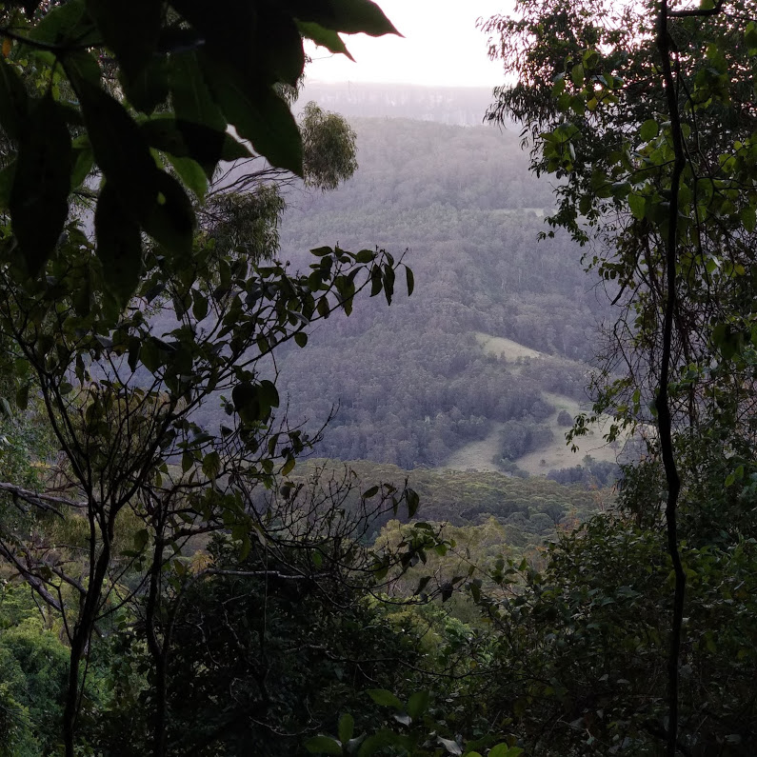
Holy God…

Slide 4
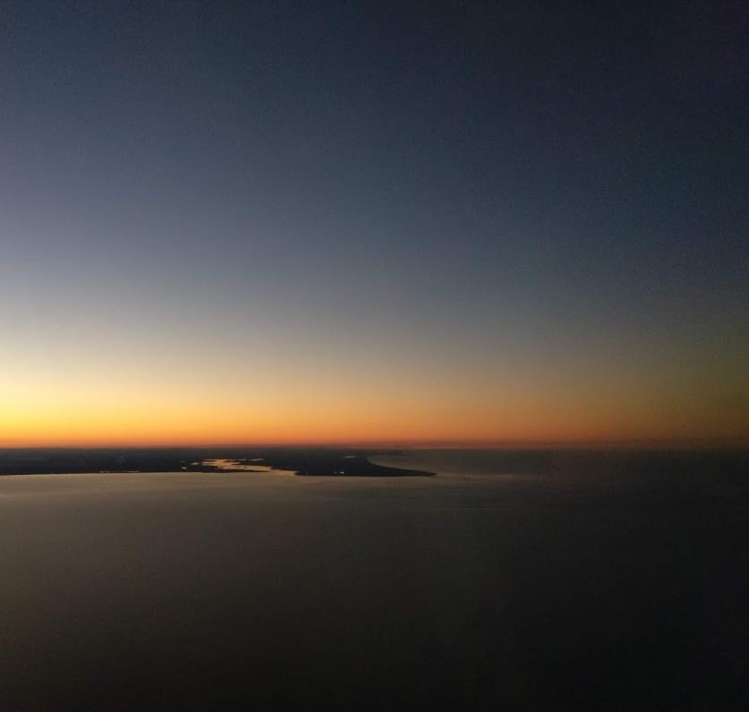
Our Creator, who walked in the dreamtime…

Slide 5
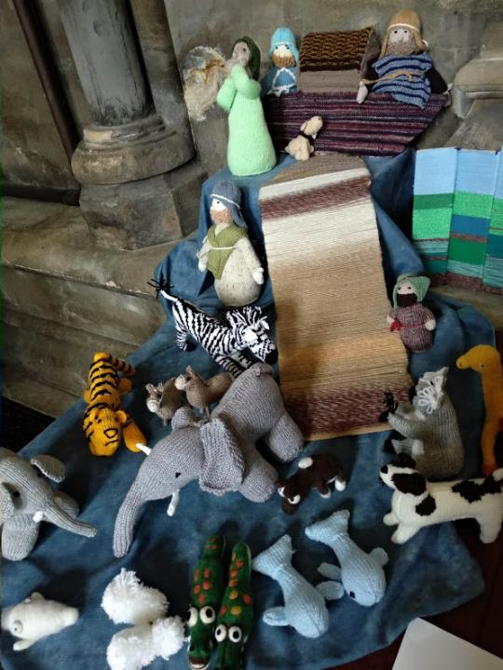
Cosmic Christ, who holds together all creation, and in whom we all live and move and have our being

Slide 6
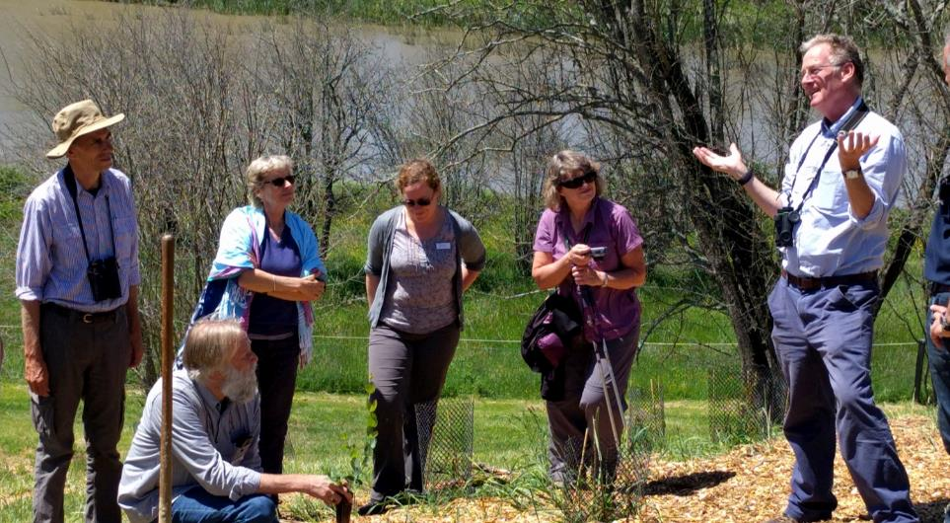
Spirit of Redemption, who shows us how to bring reconciliation, renewal and flourishing to all Creation..
A Rocha Australia

Slide 7
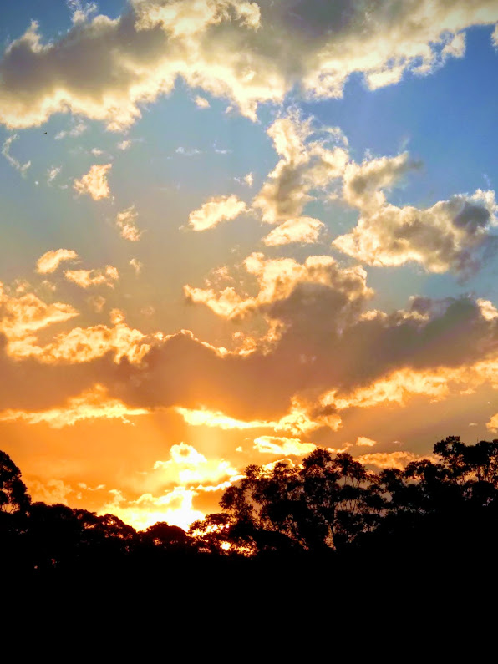
We worship you.

Slide 8
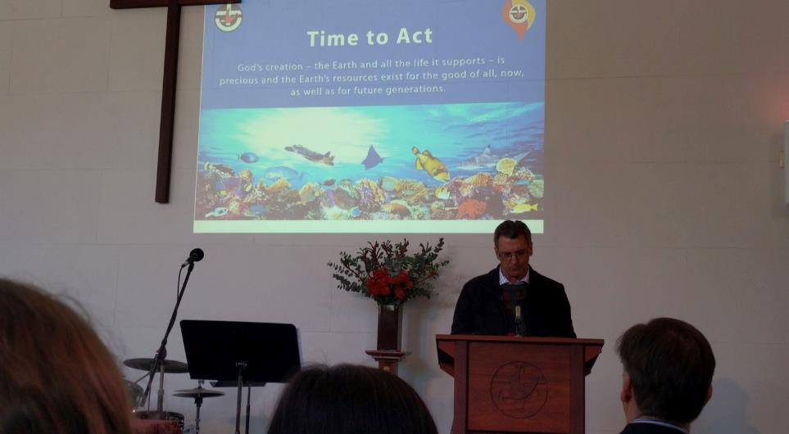
We thank you for all the churches who are inspired by you to care for Creation

Slide 9
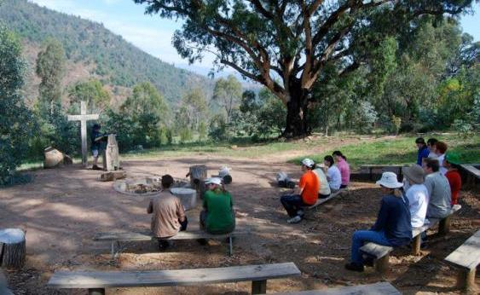
We thank you for the gift of worshipping outside…
Canberra City Uniting Church, ACT

Slide 10
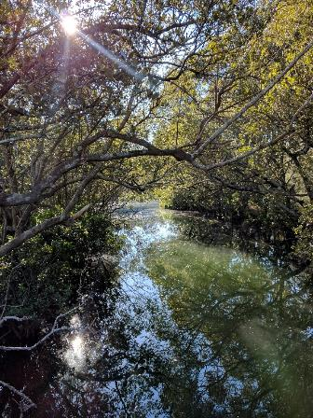
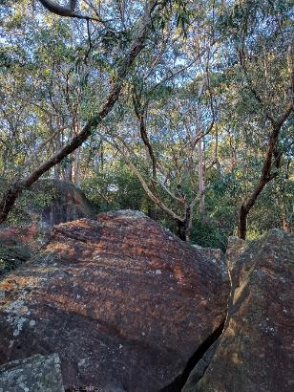
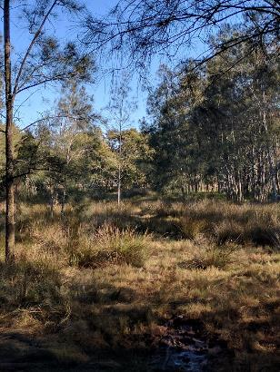
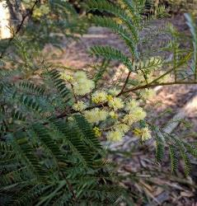
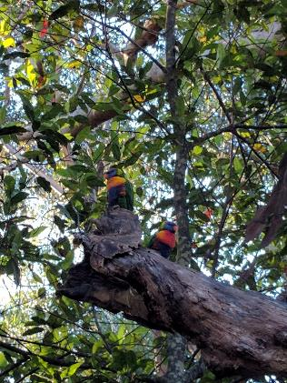
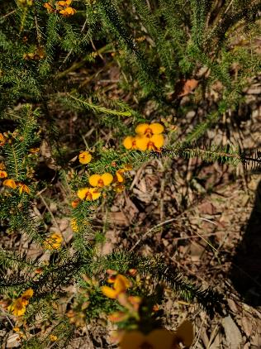
And wondering at all you have made.
Lane Cove UC and Grace UC’s Outdoor Adventure Church

Slide 11
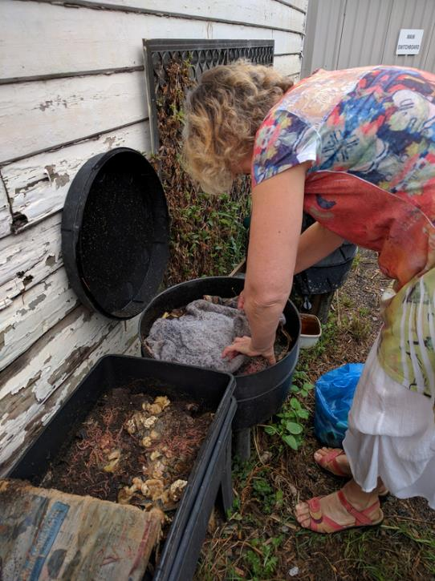
For dark and earthy things…

Slide 12
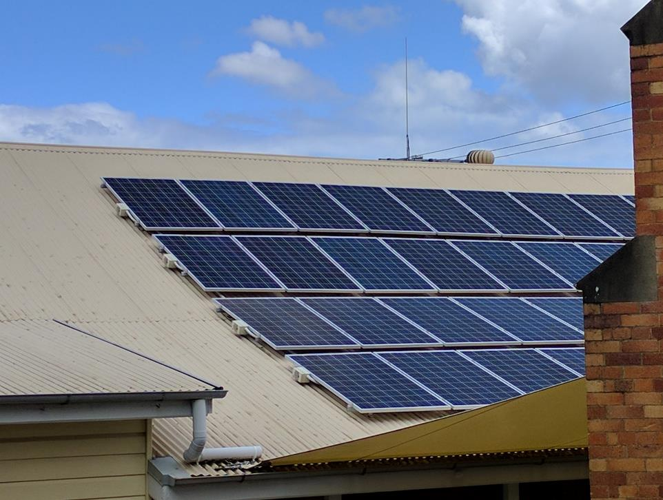
And for light and sunny things…
Indooroopilly UC

Slide 13
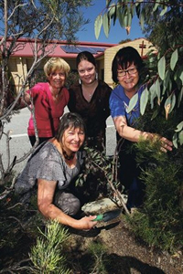
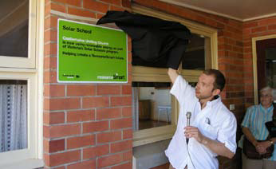
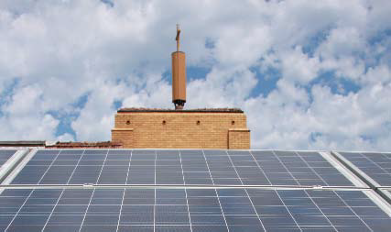
St Anselm of Canterbury Anglican Parish Kingsley-North Woodvale WA
Castlemaine Uniting Church, VIC
Bentleigh Uniting Church, VIC

Slide 14
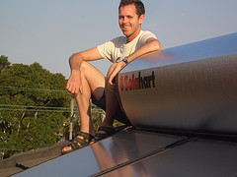
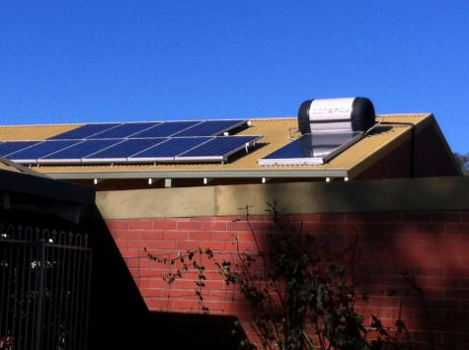
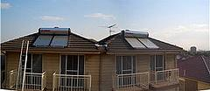
Free gifts from you.

Slide 15
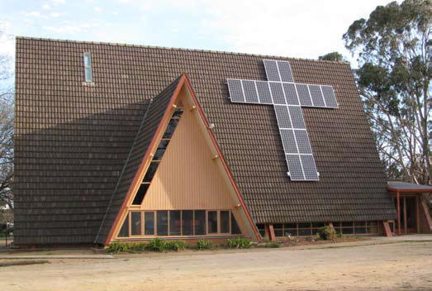
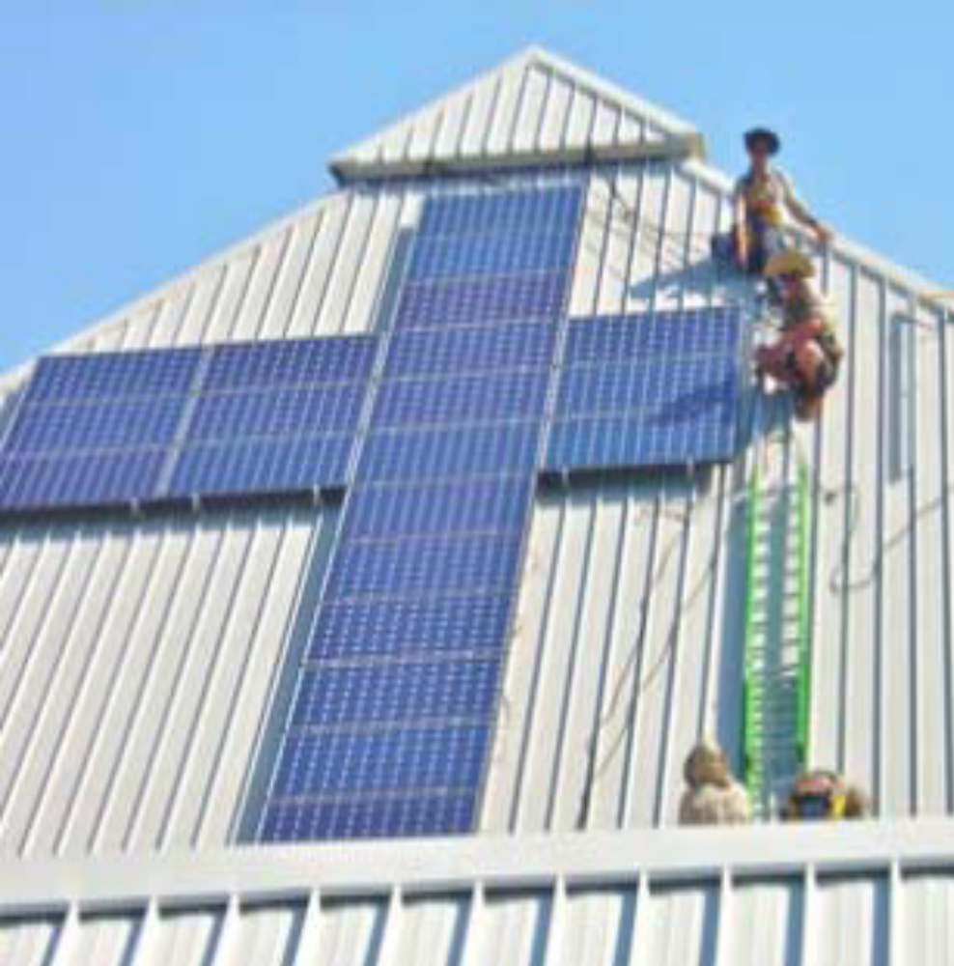
Thank you for solar crosses on churches
Caloundra Uniting Church, QLD
O’Connor Uniting Church, ACT

Slide 16
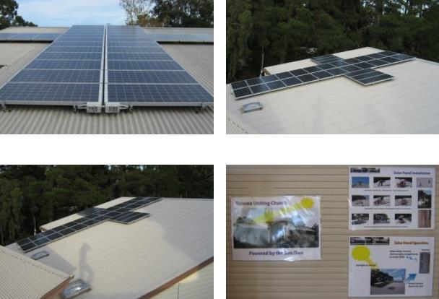
And for churches powered by the Sun/Son!
Tecoma Uniting Church, VIC

Slide 17
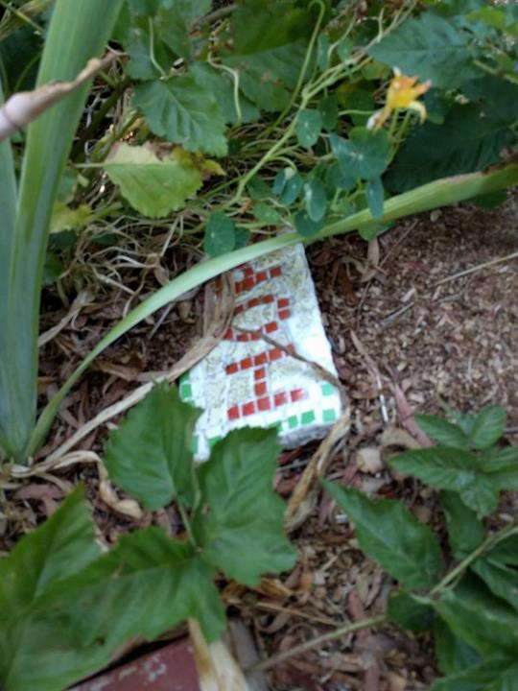
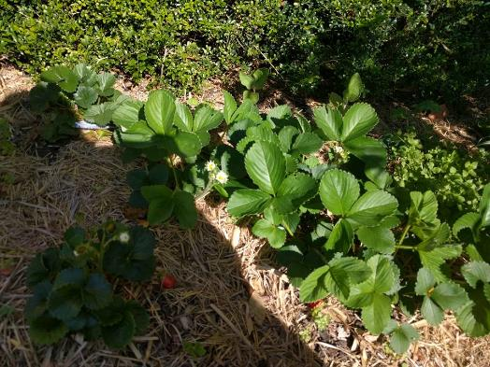
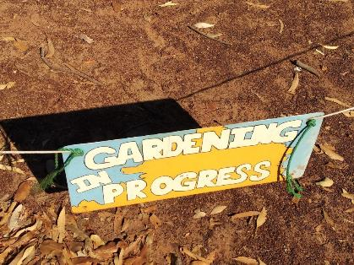
Thank you for green and growing things

Slide 18
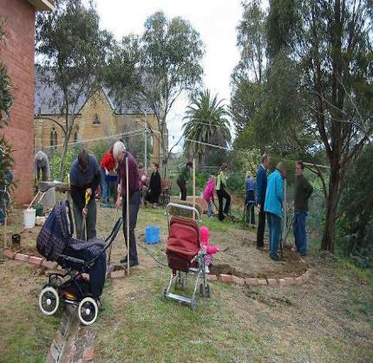
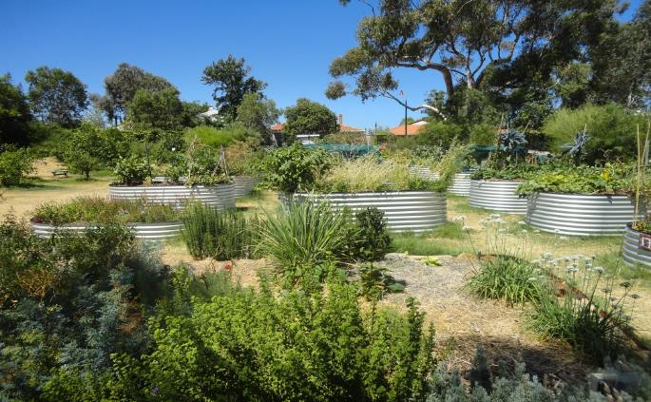
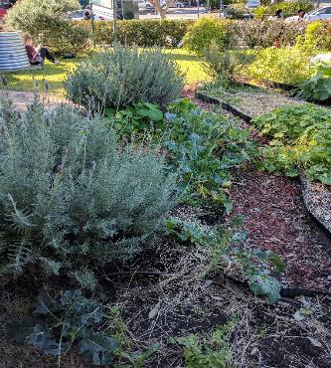
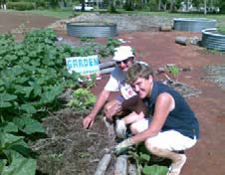
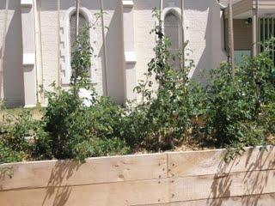
Castlemaine Uniting Church, VIC
St Luke’s Anglican Parish Mosman Park WA
Nightcliffe Uniting Church, NT
Hope Uniting Church, NSW
Port Phillip Uniting Church, VIC

Slide 19
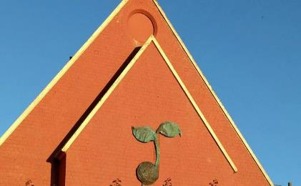
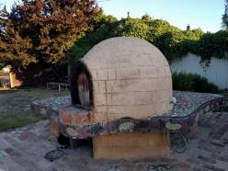
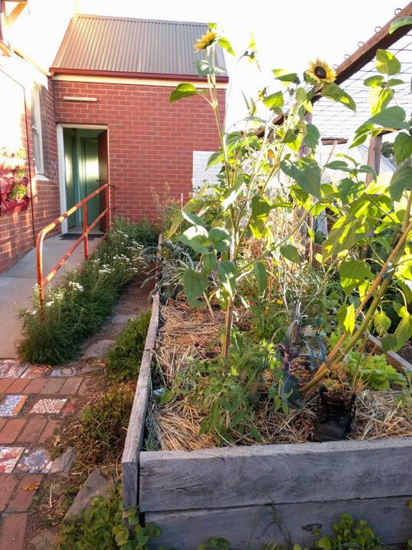
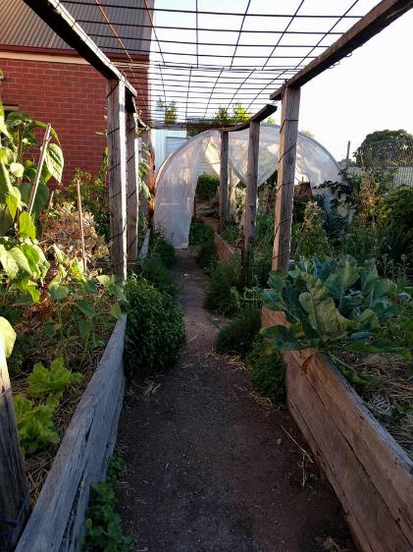
St Matthew’s Long Gully, VIC

Slide 20
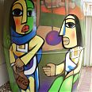
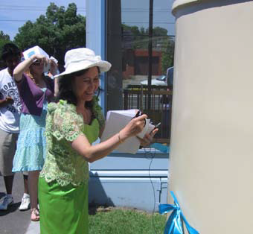
And for lifegiving water.
Springvale Uniting Church, VIC
Hope Uniting Church, NSW
Notes:
Maroubra Junction have posted the story of Delilah the water tank on the Uniting Earthweb website. It goes like this:
When we began Project Green Church, we looked at ways we could conserve our water usage. As a result we installed a 5000 ltr water tank, which services our three toilets and a garden tap. In July 2006 we installed a 5000 litre water tank that services the toilets for our preschool and our garden hose. We received subsidies totalling $2550 from Randwick City Council and Sydney Water. This simple step saves our church hundreds of litres per day.
The water tank mural
We appreciated our water tank, which we have affectionately named Delilah, but it was obvious that she was kind of on the homely side. So after watching a documentary about Sydney hip hop and graffiti artist Mistery on ABC’s Compass program we contacted Mistery and asked him if he’d like to help us beautify Delilah with a mural. We chose the image of the “Woman at the Well” not only for it’s water symbology but also for it’s strong social justice message. The woman at the well was a foreigner, a Samaritan who at the time were considered the arch enemies of the Jews. Moreover she was a woman alone at midday which meant she was even outcast from her own community. According the traditions of the time Jesus should not have spoken to her but he subverted this convention and reached out to her in the form of a teaching. So by using this image we are trying to send the message that we believe in equality, inclusiveness and justice for the marginalised.

Slide 21
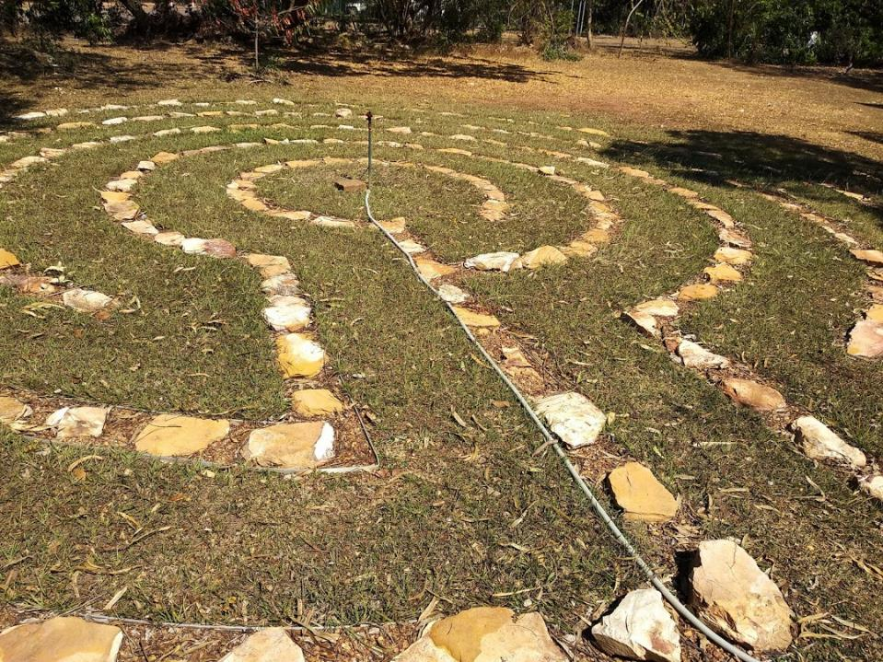
Thank you for helping us to find a way, even when things are hard.

Slide 22
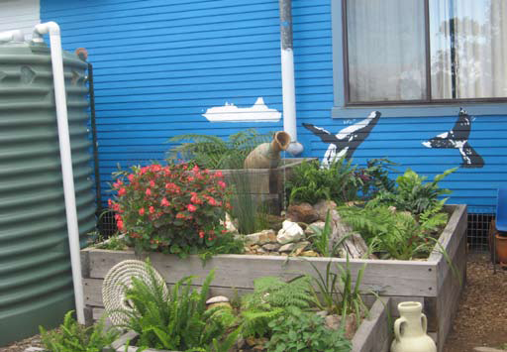
St George’s Uniting Church, Eden

Slide 23
“We started with enormous faith – and no garden tools or money to buy them. On the first day it rained and only one person turned up, Roger. As it happened he was an artist and designed our sign. And everything happened from there…”

Slide 24
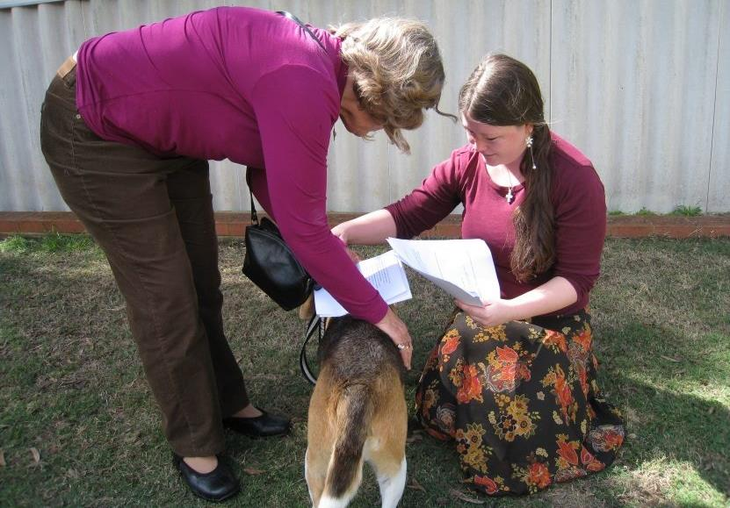
Thank you for the chance to bless our companions on the journey.
All Saints Floreat Uniting Church WA

Slide 25
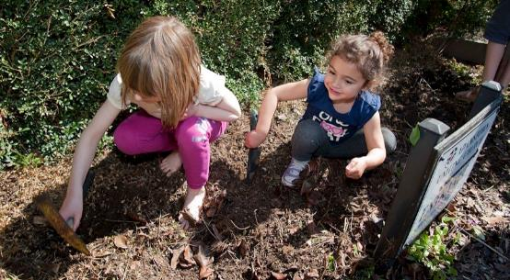
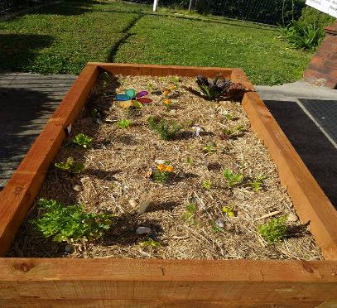
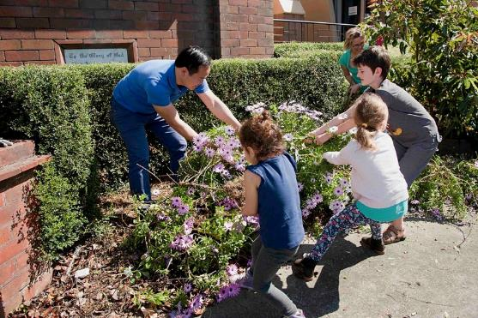
Thank you for hospitality
Children’s Garden: Adamstown Uniting Church, NSW

Slide 26
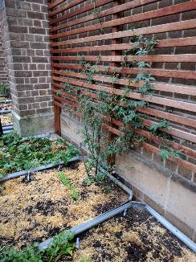
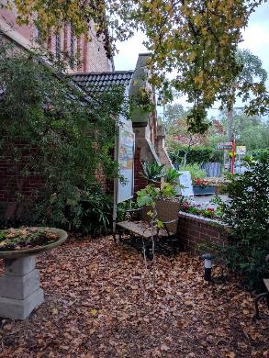
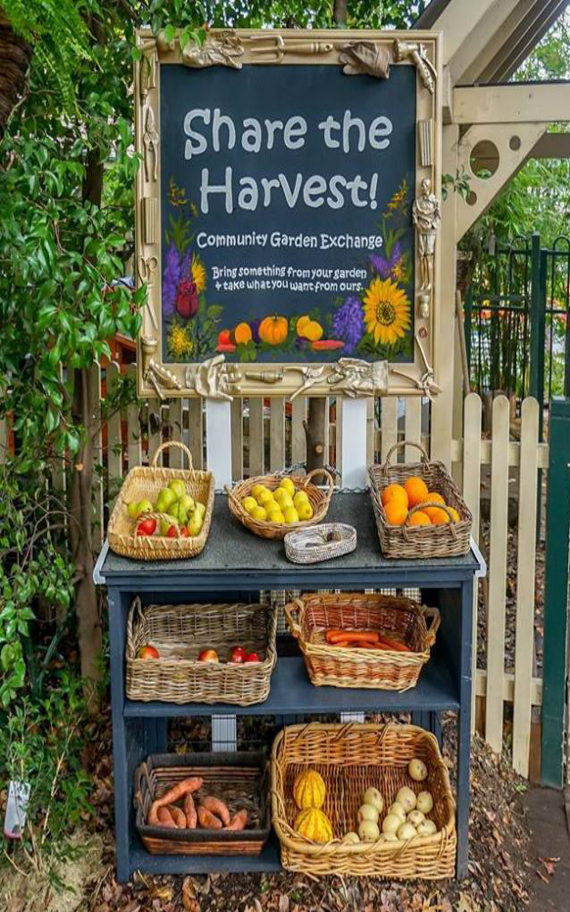
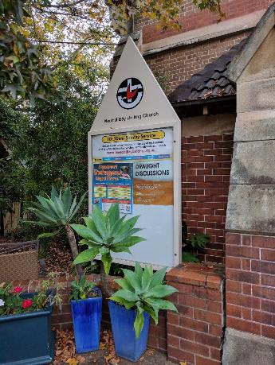


Slide 27





… and for creativity and recycling.

Slide 28







Slide 29


Thank you for the sharing of wisdom, skills and ideas.

Slide 30




Thank you for the simple changes that make a difference.

Slide 31



Thank you for those who raise their voices for action on climate,
Crossroads Uniting Church, Werribee VIC

Slide 32


for those who care for our ecosystems,
Charlestown Anglican Parish, Newcastle NSW
Before
After

Slide 33

And for those who gather to help.
Tree Planting, Metro West First Third Churches (UCA WA)

Slide 34

Thankyou for leadership,
Wesley UCIC WA,
largest solar panel installation in the Perth CBD

Slide 35

Peace wall and garden
For peace and community,
Warrandyte Uniting Church, VIC

Slide 36

And for those who come up with good ideas:
Food Co-Op: Brunswick Uniting Church, VIC

Slide 37



Thank you for our most recent award winners:
Clarence Uniting Church, TAS
Nightcliff Uniting Church, NT
Pilgrim Uniting Church, SA

Slide 38








Brisbane, QLD

Slide 39




And for all who have come before.

Slide 40







Slide 41
Thank you for all the churches in every state and territory of Australia, working to care for your Creation.
St George’s Uniting Church, Eden NSW
Charlestown Anglican Parish NSW
Sophia’s Spring: An ecofeminist community of the Uniting Church at CERES VIC
Brunswick Uniting Church VIC
Adamstown Uniting Church NSW
St Mark’s Anglican Church South Hurstville NSW
Warrandyte Uniting Church VIC
St Anselm of Canterbury Anglican Parish Kingsley-North Woodvale WA
St Luke’s Anglican Parish Mosman Park WA
Ross Memorial Uniting Church WA
Wembley Downs Church of Christ WA
Victoria Park and Districts Uniting Church WA
St Luke’s Anglican Parish Maylands WA
Pinjarra Uniting Church WA
Churches with Five Leaf Eco-Awards

Slide 42
Uniting Church in the City, Wesley Church WA
Merewether Uniting Church NSW
South Sydney Uniting Church NSW
St Luke’s Uniting Church, Highton VIC
Nightcliff Uniting Church NT
St John’s Anglican Cathedral Brisbane QLD
Pilgrim Uniting Church, SA
Clarence Uniting Church, TAS
Port Melbourne Uniting Church VIC
Maroubra Junction Uniting Church NSW
Ecofaith Community Bellingen NSW
Springwood Uniting Church NSW
Ss Peter and Paul Catholic Parish Kiama NSW
Canberra Baptist Church ACT
St Denis’ Catholic Parish Joondanna WA
St Saviour’s Anglican Church, Boyup Brook WA
Swan View Uniting Church WA
Canberra City Uniting Church ACT
Kippax Uniting Church ACT
St Ignatius Jesuit Community Riverview NSW
A GRAND STAND for the Environment VIC
Greenhills Centre (venue)
Churches with Five Leaf Eco-Awards cont…

Slide 43

Thank you for a wonderful first decade of the
Five Leaf Eco-Awards!

Slide 44

Please bless all of our current and future churches, and each and every person who worked to earn awards and help their churches to become more environmentally friendly!

Slide 45

And help us to work together for mutual support and encouragement, and to bring about the flourishing of your whole creation.
Amen.

Slide 46

For more info: http://fiveleafecoawards.org/

